Slide 1
PYNQ 501: Computer Vision Presenter: Brady Schmelling
PYNQ Bootcamp 2026 7/29 9:30 - 10:45

Slide 2
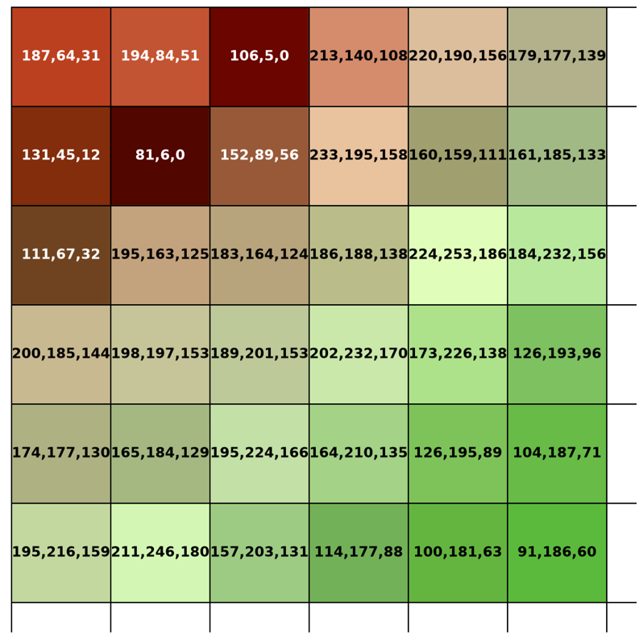
What is Computer Vision?
• You and I look at a picture and instantly understand it - a cat, a stop sign, a friend's face
• A computer just sees a grid of numbers. It has no idea what those numbers mean
• Computer Vision is taking that data and transforming it into something the computer can use
• Difference between computer vision and CNNs:
– Classic Computer Vision (today!) - step-by-step math ‘recipes’ written by humans
– CNNs (Convolutional Neural Networks) - the computer learns the recipe itself from examples
Pixels with RGB values overlaid. We will visit this again on a later slide

Slide 3
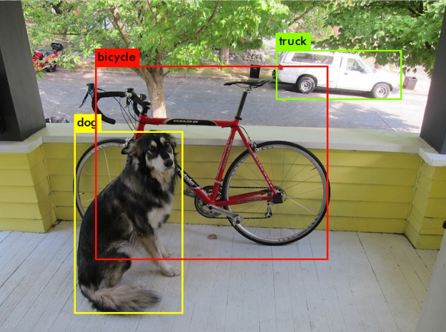
Why This Matters For the Competition
CNNs are only as good as the data you feed into them
If you can help focus what the computer “sees” the CNN will perform more faster and more reliably
If you get the chance to include some of these in your project your CNN model may run faster and detect more reliably
Real YOLOv3 output from PYNQ 301 — one photo, three objects found at once

Slide 4
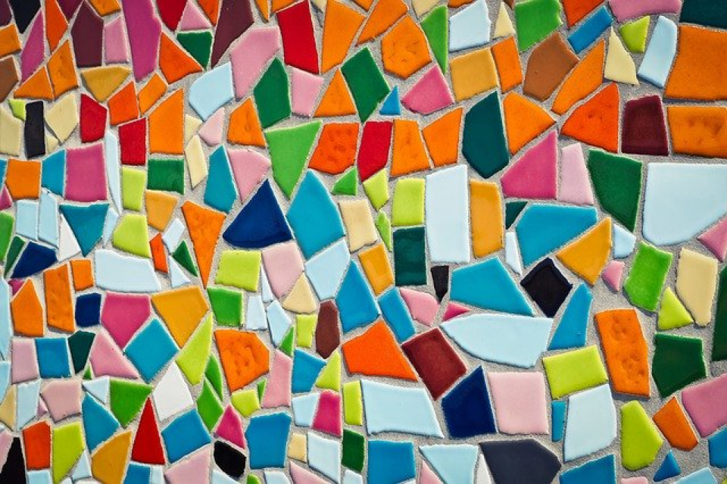
Meet OpenCV
• OpenCV is an open-source toolbox of computer vision building blocks.
• It's used in robots, phones, self-driving cars, drones, and video games.
• Today we'll use it in Python to explore this mosaic image.
• Every trick we learn works the same way on any picture - or on video from a camera!

Slide 5

Pictures Are Just Numbers
• Zoom in far enough and every image is a grid of tiny squares called pixels.
• Each pixel stores 3 numbers: how much Red, Green, and Blue light it has (0–255).
• Our full mosaic image is a grid of 426 x 640 pixels, each with 3 color numbers — that's over 800,000 numbers!
• Every OpenCV trick today is just math applied to this big grid of numbers.

Slide 6
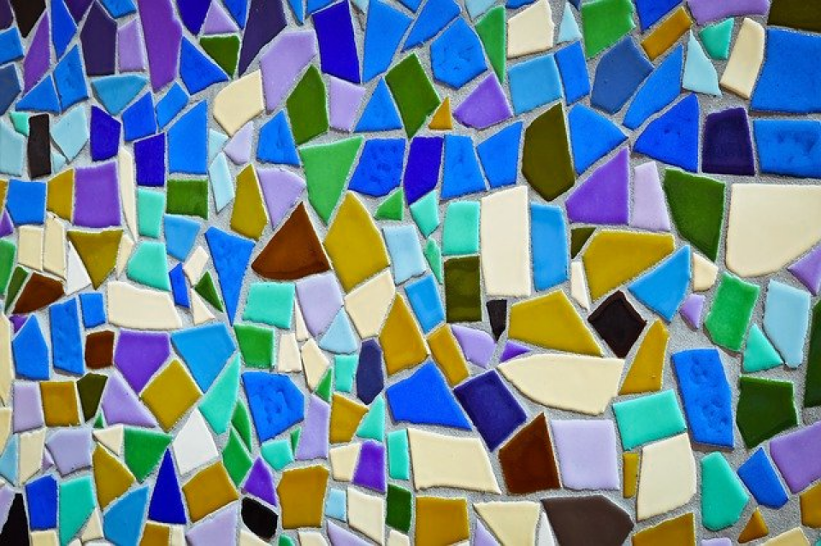
OpenCV's Secret: It Stores Colors Backwards!
Correct order: Red, Green, Blue
Mixed up: Blue and Red swapped
Notes:
Computers store a color image as three numbers per pixel: Red, Green, and Blue. OpenCV actually stores those three numbers in the opposite order — Blue, Green, Red. If you forget to flip them back before displaying, the colors come out wrong. Ask students to spot the difference between the two images (skin looks blue, sky looks orange, etc.). This mix-up trips up beginners constantly, so it's worth remembering. Why does OpenCV do this? OpenCV was created at Intel in 1999, when BGR was the common byte order used by camera hardware/frame grabbers and the Windows BMP format of that era. OpenCV adopted BGR to match, and it's stuck
that way for backward compatibility ever since

Slide 7
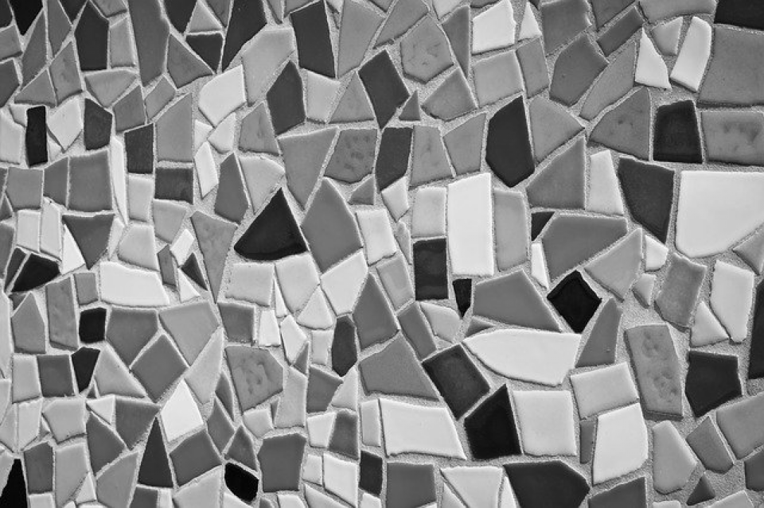
Grayscale: Removing the Color
Original (3 numbers per pixel)
Grayscale (1 number per pixel)
Notes:
Ask: why would we ever want to throw away color? Grayscale keeps only brightness, not color, so there's just 1 number per pixel instead of 3. That makes it much faster and easier for a computer to find edges and shapes. Mention grayscale is often the very first step before other vision tricks, like the corner detecton

Slide 8
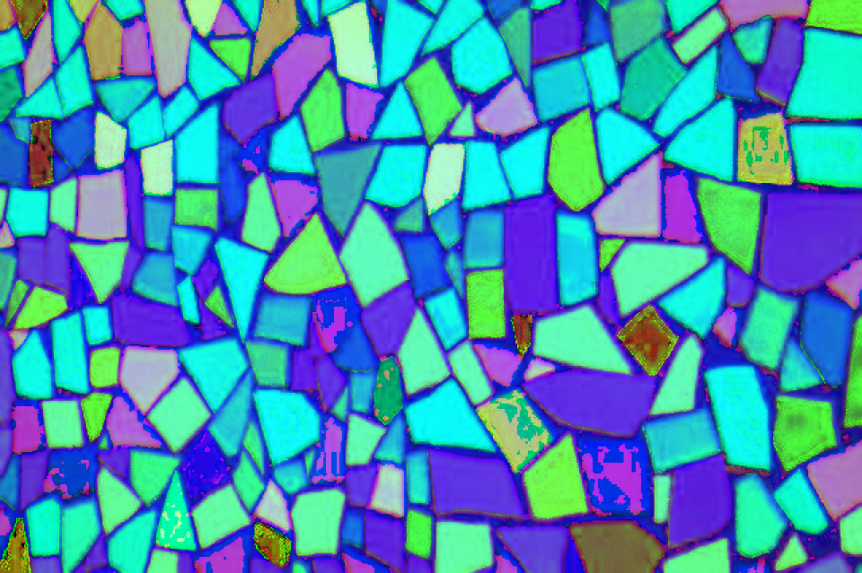
HSV: A Different Way to Describe Color
RGB: Red, Green, Blue amounts
HSV numbers, shown as if R,G,B
Notes:
HSV is another way to describe color: Hue = which color on the color wheel, Saturation = how vivid or washed out, Value = how bright or dark. Point out the right-hand image looks strange/psychedelic — that's because we're tricking the display into showing HSV numbers as if they were RGB numbers. Mention HSV is handy for tasks like 'find everything that's red,' since hue separates color from brightness/lighting.
Why would you need to do this?
HSV separates color identity from lighting. Hue encodes which color it is (position on the color wheel), while Saturation and Value absorb most of the vividness/brightness variation. So "red" stays roughly the same Hue whether it's in shadow or full sun. This makes HSV thresholding/masking much more robust
for isolating objects by color than RGB thresholding.

Slide 9
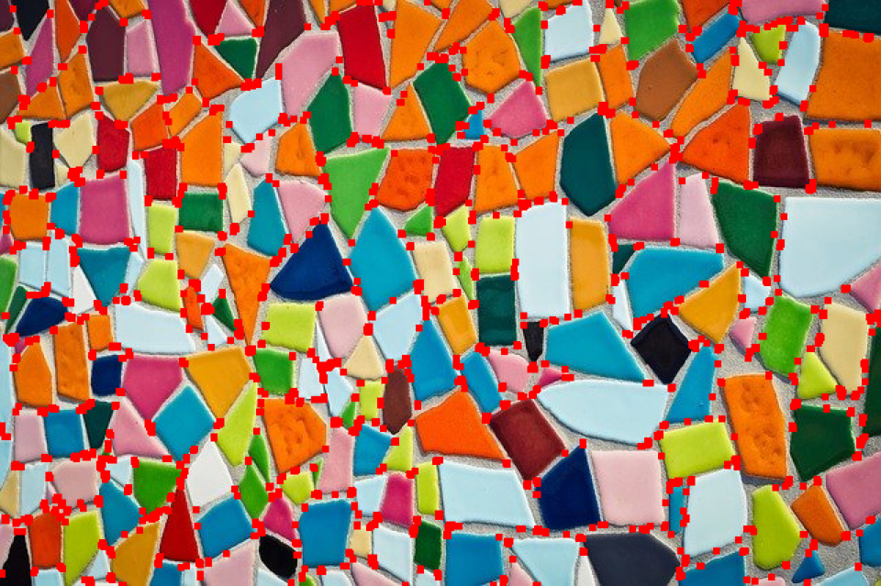
Finding Corners
Original image
Red dots = corners the computer found
Notes:
A corner is a point where two edges meet — an easy landmark for a computer to spot again in the next video frame. Ask why that matters: corners are used to track moving objects, stitch photos into a panorama, and help AR apps stick a filter onto a face. The red dots show every spot the Harris Corner Detector flagged as a corner.

Slide 10
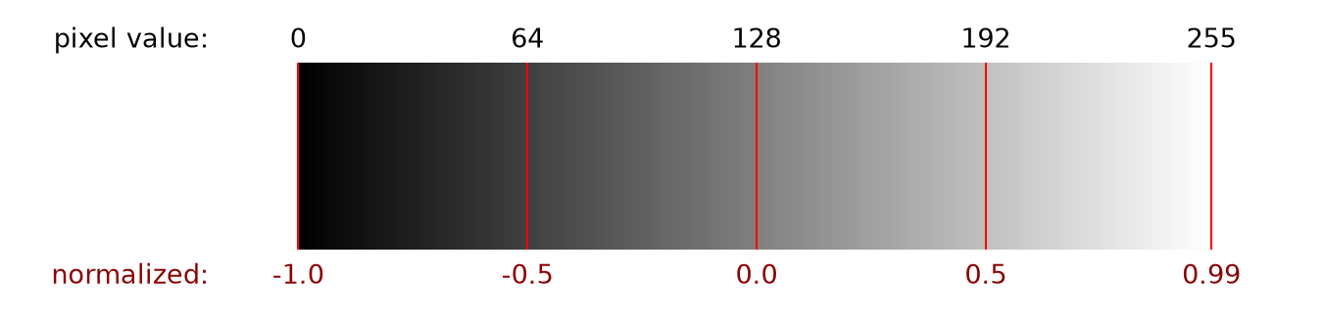
Normalizing Images
• Pixel values normally range from 0 to 255.
• AI models often learn faster and better with small numbers centered around 0.
• Normalizing squeezes 0–255 down into the range -1 to 1.
• The picture looks the same to us — it's just friendlier math for the computer.

Slide 11
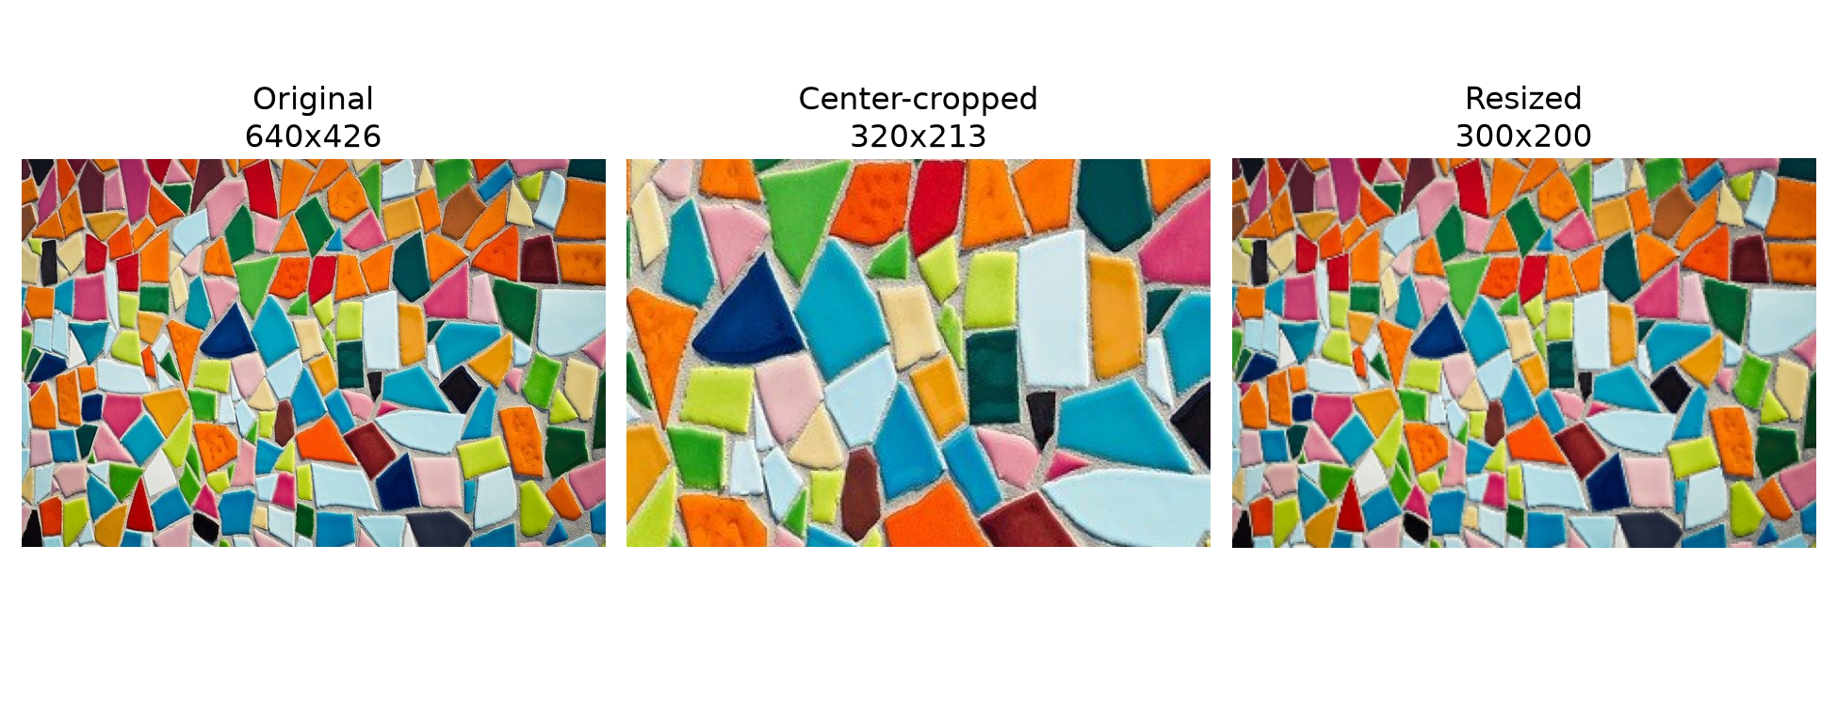
Cropping & Resizing
• Cropping zooms into the center of an image, cutting away the edges.
• Resizing shrinks or grows an image — keeping its shape correct (aspect ratio) so it doesn't look stretched or squished.
• These tricks are used constantly to prep images before feeding them into AI models.

Slide 12

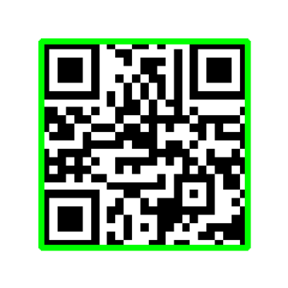
QR Codes: Not Just for Menus!
A generated QR code
Detected & decoded: amd.com
Notes:
Ask who has scanned a QR code with their phone — probably everyone. A QR code works a lot like an ArUco marker, but instead of just an ID number it hides a chunk of text or a web link. The green outline is OpenCV finding the code, and the decoded text underneath is OpenCV reading it, exactly like a phone camera app does.

Slide 13

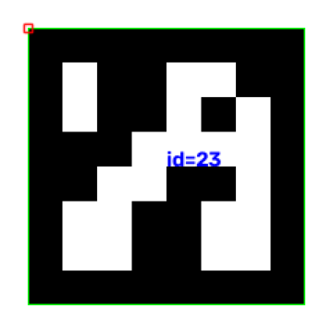
ArUco Markers: Tags Robots Can See
A generated ArUco marker (id 23)
Detected! The computer read id = 23
Notes:
ArUco markers are like a robot's version of a name tag — a computer can read them from far away and at an angle. They're everywhere in robotics competitions and warehouses to help robots figure out exactly where they are. Point out that the detector didn't just find the marker, it read the exact ID number (23) and all four corners, which tells you the marker's precise position and rotation. ArUco: Augmented Reality University of Cordoba

Slide 14
Summary:
• Images are grids of numbers - that's all a computer sees.
• We converted between color spaces: RGB, Grayscale, and HSV.
• We found corners in an image using the Harris Corner Detector.
• We normalized, cropped, and resized images to prep them for AI models.
• We detected ArUco markers and read their ids - like a robot's barcode.
• We detected and decoded QR codes hidden inside an image.

Slide 15
Notes:
Wrap up: ask if there are any questions. Remind students where to find today's notebook and encourage them to try the bonus webcam challenge if they have extra time. Thank them for participating.

